Slide 1
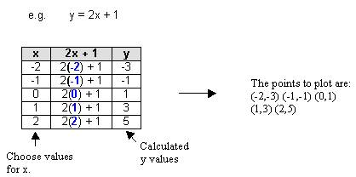
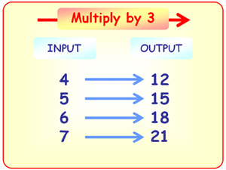
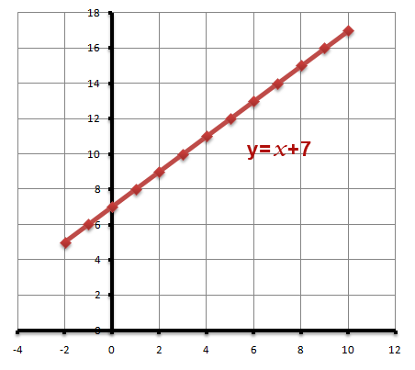
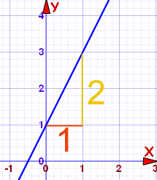
Straight Line Challenges

Slide 2
Challenge 1
What does this machine do to each number?
1
2
3
4
5
3
4
5
6
7

Slide 3
Challenge 2
Put the numbers in and write down the answers which come out.
1
2
3
4
5
?
?
?
?
?

Slide 4
Challenge 3
Complete the tables for each of the given equations.
y = 3x
y = 2x + 4
y = 3x - 4
x | x3 | y
1 | x3
2 | x3
3 | x3
4 | x3
x | x2+4 | y
1 | x2+4
2 | x2+4
3 | x2+4
4 | x2+4
x | x3-4 | y
1 | x3-4
2 | x3-4
3 | x3-4
4 | x3-4

Slide 5
Challenge 4
Plot these points to draw the 3 Graphs
y = x + 3
y = 2x - 1
y = 3x + 1
x | y
1 | 4
2 | 5
3 | 6
4 | 7
x | y
1 | 1
2 | 3
3 | 5
4 | 7
x | y
1 | 4
2 | 7
3 | 10
4 | 13

Slide 6
Challenge 5
Complete the tables for each of the given equations and draw the graphs
y = 2x
y = 2x + 4
y = 3x - 4
x | y
1
2
3
4
x | y
1
2
3
4
x | y
1
2
3
4

Slide 7
Challenge 6
Complete the tables for each of the given equations and draw the graphs
x + y = 8
y = 2x - 4
y = x - 4
x | y
1
4
7
8
x | y
1
2
6
 | 12
x | y
 | -4
3
7
 | 6

Slide 8
Challenge 7
What does this machine do to each number?
1
2
3
4
5
6
8
10
12
14

Slide 9
Challenge 8
Write down 3 equations which go through each of the points
Q1. (3 , 3)
Q2. (4 , 1)
Q3. (3 , 5)

Slide 10
Challenge 9
Write down 2 solutions to each of these problems
Q1. A line parallel to y = 2x + 4
Q2. A line steeper than y = 3x - 4
Q3. A line that crosses the y axis at 3

Slide 11
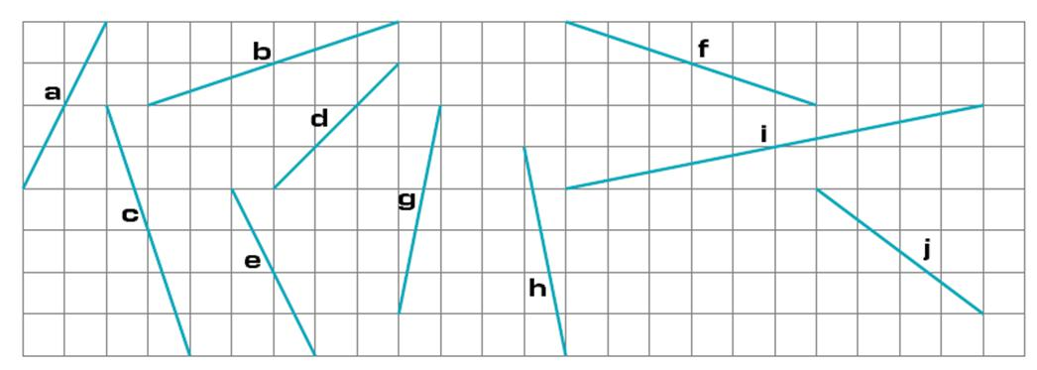
Challenge 10
Find the gradients of each of these lines.

Slide 12
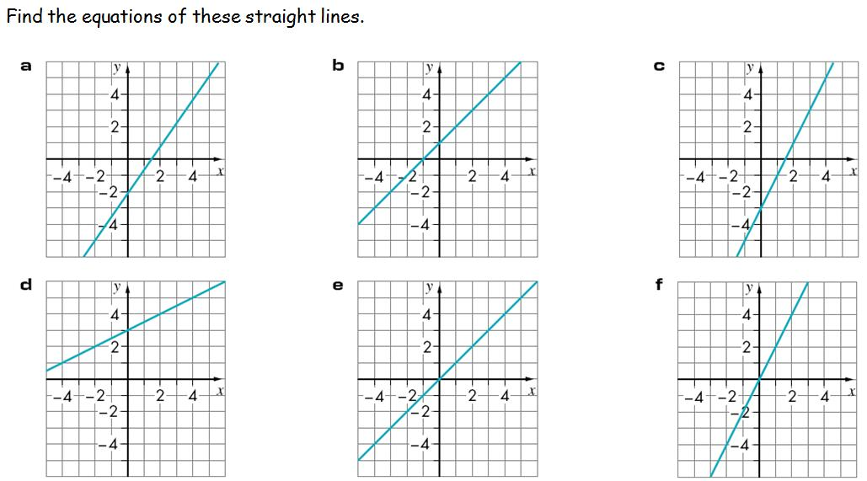
Challenge 11
Find the equation of each of these 5 lines.

Slide 13
Challenge 12
Find the equation of the 5 straight lines below. You are given 2 points on each line.
Q1 | (1,4) | (3,10)
Q2 | (0,3) | (4,11)
Q3 | (2,6) | (5,18)
Q4 | (1,7) | (4,10)
Q5 | (4,6) | (7,12)

Slide 14
Challenge 13
Find the equation of each of these 5 lines.
y
5
10
1
9
8
7
6
2
5
4
4
3
2
1
x
-10
-9
-8
-7
-6
-5
-4
-3
-2
-1
0
1
2
3
4
5
6
7
8
9
10
-1
6
-2
-3
-4
3
-5
-6
-7
-8
-9
-10

Slide 15
Challenge 14
Find the length of the line which joins each of these pairs of points.
Q1 | (1,4) | (3,10)
Q2 | (0,3) | (4,11)
Q3 | (2,6) | (5,18)
Q4 | (1,7) | (4,10)
Q5 | (4,6) | (7,12)

